Slide 1
Calleebree Data Model, Permissions, User Stories
20.06.2022

Slide 2
Agenda
1 |  | Setup Service Provider Model & real-life scenarios
2 |  | Setup Advertiser Model & real-life scenarios
3 |  | General Principles Over-arching rules and concepts
4 |  | Specific User Journeys Real-life scenarios with specific people
5 |  | Other

Slide 3
Setup | Service Provider
Files are always uploaded on «Brand» and, assigned 100% to root «CallCenter» and split between «Sites»
Seperation between «Sites» should be assumed to be strong (otherwise, use «Team»), each having it’s own commission model.
Should we allow organization to see commissions below Accounts??? Yes, at least for sites, but most likely also for «Teams»
CallCenter ABC
Telecom / Brand #1
Site A
Team (a)
Telecom/ Brand #2
Site C
Insurance / Brand #3
Team (b)
Site B
Team (c)
Team (d)
Team (e)
Site A’
Team (f)
Team (g)
Site D
Team (h)
Organization (Service Provider)
Brands
Sites (Service Provider / Subsidiaries / Production Sites)
Teams
Agents

Slide 4
Setup | Service Provider | Subsidiaries | WebHelp
WebHelp
Yallo / Lebara / swype
WebHelp Turkey
Acquisition DE
PYUR
WebHelp Portugal
Generali
Retention DE
WebHelp Tunisia
Mixed FR
Acquisition FR
Retention FR
WebHelp Turkey
Mixed DE
Mixed IT
WebHelp Morocco
Retention FR
Organization (Service Provider)
Brands
Sites (Service Provider / Subsidiaries / Production Sites)
Teams
Agents

Slide 5
Setup | Service Provider | Sub-Contractors | ganira
ganira
Yallo / Lebara / swype
DCS
German
PYUR
iGrow
Generali
French
Nexus
Team (c)
Acquisition
Retention
DCS
Team (f)
Team (g)
Ganira PT
Team (h)
Organization (Service Provider)
Brands
Sites (Service Provider / Subsidiaries / Production Sites)
Teams
Agents

Slide 6
Agenda
1 |  | Setup Service Provider Model & real-life scenarios
2 |  | Setup Advertiser Model & real-life scenarios
3 |  | General Principles Over-arching rules and concepts
4 |  | Specific User Journeys Real-life scenarios with specific people
5 |  | Other

Slide 7
Setup | Advertiser
Mostly: we swap «Brands» & «Call Centers»
Files are always uploaded on «Brand» and split between «CallCenters», and split again between Sites
Organization shall not see the commission details below «Sites»
Telecom Brand ABC
Call Center / Partner #1
Team (a)
Call Center / Partner #2
Call Center / Partner #3
Team (b)
Team (c)
Team (d)
Team (e)
Team (g)
Team (h)
Organization (Brand)
Sites (Service Provider / Subsidiaries / Production Sites)
Teams
Brand ABC
Brands
Brand XYZ
Team (f)
Agents

Slide 8
Setup | Advertiser | Sunrise-UPC
Sunrise-UPC AG
Speeex
Mobile ACQ
ganira
WebHelp
Retention
Team (c)
DCS-1 (d)
DCS-2 (e)
Team (g)
Team (h)
Organization (Brand)
Sites (Service Provider / Subsidiaries / Production Sites)
Teams
Yallo / Lebara / Swipe
Brands
Sunrise / QoQa
Nexus (f)
Agents

Slide 9
Agenda
1 |  | Setup Service Provider Model & real-life scenarios
2 |  | Setup Advertiser Model & real-life scenarios
3 |  | General Principles Over-arching rules and concepts
4 |  | Specific User Journeys Real-life scenarios with specific people
5 |  | Other

Slide 10
General Principles | Users & Accounts
A User shall relate to a physical person, while an account shall define it’s role in a given context
User
A User allows to uniquely identify a person
Unique email address (primary key)
Phone number (not necessarily unique, used for example for 2-Factor Authentication)
Various personal details (ex: avatar, name…)
Password or other authentication mechanism
1 User may be linked to 1 more more accounts
After login, a User must then choose an Account when multiple active accounts are available
Account
An account links a person (a User) to a role
Unique User ID
Unique ID identifying the specific node/path in the Model/Tree
Roles are typically defined by their level in the tree (ex: Site manager can manage his Site & related Teams) (some special case come come in addition, for example: read only roles)
Brand-Organization define a context; Site-Team-Agent define a context
Write permissions are limited within a given context (and still follow the hierarchy)
Read permittions may be shared across context and at least extend to level below
*no* personal details (only at User level)

Slide 11
General Principles | Campaigns
A File exclusively belongs to 1 Campaign and cannot be switched to any other Campaign or Brand
Brand
(1) Name
(1) Description
(1) Logo
(1) Country
(1-5) languages
(n) FAQ
(n) Quizz
(0-5) USP (keywords or very short sentences)
File 4
File 3
File 2
File 1
(1) Name
(1) Description
(1) Source
(1) Source Type
(1) Produced Date
(1) Expiration Date
(1) Upload Date
(n) Tags
(json) Quality
Product D
Product C
Product B
Product A
(1) Name
(1) Description
(1) Public Description
(1) Price
(n) FAQ
(n) Quizz
(0-5) USP
(n) Tags
n
n
1
n
Campaign
(1) Name
(1) Description (internal)
(1) Public Description (for offers per emails to customers)
(n) FAQ
(n) Quizz
(0-5) USP
(1) Category [ACQ, X-SELL, UP-SELL, RET, Other]
(n) Tags
(1) Brand
(n) Attributes (expected columns in files, including type)
1
n
1
n
A Product can be used in several Campaigns, tags should typically be used to filter the right products
Contact N
Contact 3
Contact 2
Contact 1
(1) File
(1) Site
(1) Team
# of attempts
First attempt
Last attempt
Quizz
(1) Question
(3-5) Answers
(1) Solution [ 0-n Valid answer(s) ]
(1) Weight [0-100]
Site
Quizz can be defined at various level. Before an Agent starts in a Campaign,3 to 5 applicable Quizzes (configured in Campaign settings) from all levels are randomly selected according to their weights and shown to the Agent
Once assigned to a Team, a contact cann never be re-assigned to another Team or Site/Partner
Team

Slide 12
File Upload | Flow | Phase 1
Brand Manager
Drag’n Drop file
Clean file with lead management API
Display File Info & Quality
Map non-core columns to Campaign attributes
Provide specific information
File name, description, source, produced date (can be set in the past; default: now), expiration date (default: produced + 3 months), tags…
Split file to Sites/Partners (default: in Campaign settings)
For each language in Brand: define weight of each partner
Site/Partner Manager
Review Info & Quality
Split file to teams (default: in Partner settings for this team)
For each language in Brand: define weight of each partner
Team Manager
Review Info & Quality (default: in Campaign settings for this team)
Activate File for Team (default: inactive)
Note: Select Agents to be excluded at Campaign level, not at File level
A default shall be defined in the Campaign settings, which itself is set by default with an even distribution between all partners.
Whenever a new partner is added, the Campaign default is re-initialized.
Ganira PT
22%
DCS
36%
Nexus
42%
German

Slide 13
File Upload | Flow | Phase 2
File Upload (in the future) shall be done outside of calleebree, without User/Account, but using a secure upload link. Brand manager(s) should then be notified to validate the upload and dispatch the file.
Upload
[optional] Request upload in Campaign
Upload screen
Validate
Request for validation
Link to validation page
Validation screen
[validate]
Propose file split between «Sites»
Finalize file split
Dispatch
Split according to rules
SMS / Email sent to Campaign Manager
Show file statistics
Email sent to pre-approved contact
Link to upload page
Drag’n Drop file
Clean & normalize file
Show file statistics
[Confirm]
Tag all contacts with specific site
Task in Task List of Campaign Managers
Request for Team assignment
Task in Task List of Site Manager
Show statistics for file subset
CANNOT BE CHANGED
Email / SMS to Site Manager
Propose Team allocation
[validate]
Inform Team Leads
Email / SMS / Task: new File available
[Activate]
Define file validity (will be automatically archived after)
Link to file info page

Slide 14
General Principles | Contract Value / Commissions
Commissions follow the Model and can be defined at all levels starting from Organization down to Agent.
The margin is the commission at a level after deducting the commissions from the level immediately below.
ganira
Yallo / Lebara / swype
DCS
German
PYUR
iGrow
Generali
French
Nexus
Team (c)
Acquisition
Retention
DCS
Team (f)
Team (g)
Ganira PT
Team (h)
Organization (Service Provider)
Brands
Sites (Service Provider / Subsidiaries / Production Sites)
Teams
Agents
200chf
/sale
150€ /sale
300€ /sale
60€ /sale
65€ /sale
-
-
-
-
-
-
45chf
/sale
35chf
/sale
10€ /sale
15€ /sale
-
10€ /sale
8€ /sale
10€ /sale
15€ /sale
50€ /sale
45€ /sale
85€ /sale
Commission shall be seen as a contract value, thus also valid at organization level if the organization is an Advertizer (ex: Salt)
This allows to quickly calculate at all level the margin by deducting the commission from the nearest non-null level below.

Slide 15
General Principles | Contract Value / Commissions
Commission
Value
Fixed amount
Incremental amount (value, no currency)
Uplift (%)
Currency is inherited from Node in model and needs to be persisted on sales object to avoid errors if changes happen later in the model
ID of Node in model (Organization, Brand, Site, Team, Agent)
Sale
Shall include the calculated commission / contract value for all levels of the hierarchy
Ex: ContractValueOrganization=null, currencyOrganization=EUR, ContractValueBrand=152, currencyBrand=CHF, …, ContractValueAgent=9, currencyAgent=TRY
Shall include the calculation details (json) of the commission / contract value
Ex: { organization { fixed=150, currency=EUR, campaignUplift=+20%, productUplift=-30% }, partner { fixed=50, currency=CHF, campaignIncrement=+10 }, agent { fixed=10, currency=TKL, ProductIncrement=5 } }

Slide 16
Other important Model consideration
Organization
Has a currency
Brand
Defines the operating country (and applicable laws)
Defines the operating languages
Including a default language, for example, German in Switzerland or English in the USA
Campaigns & products shall all support multi-language
The descriptions are entered in the default languages
Automatically translated with Deepl (then flagged as “generated”)
Can then be overwritten (flag then removed once edited)
Has a currency
Partner
Has a currency
Team
Has a currency

Slide 17
Other Model consideration
Contact Reasons
High level shall be clearly normalized
For each reason, it shall be possible to either select a sub-reason (defined at Campaign level with a default from Brand, and Organization) or enter a text, or both, or none

Slide 18
Other important Roles considerations
Organization
Manages payment information
Brand
Enables { Partners, language } for each Campaign (at Campaign level)
Partner
Enables { Teams, language) for each Campaign enabled for this partner
Team
Exclude selected agents from Campaigns (default is all agents in a team participate if the partner manager assigned the Campaign to the team and the Campaign is activated)
Manage priorities between Campaigns assigned to team (high, medium, low, off => every )

Slide 19
Agenda
1 |  | Setup Service Provider Model & real-life scenarios
2 |  | Setup Advertiser Model & real-life scenarios
3 |  | General Principles Over-arching rules and concepts
4 |  | Specific User Journeys Real-life scenarios with specific people
5 |  | Other

Slide 20
Use Case: «Dirk»
TO BE CHECKED
Campaign Manager
For the brand «Salt»:
Can manage campaign types
add, remove (if empty), de-activate
Attributes:
Title
Description
Tags [List]
FAQ [list]
Quizz [list]
ex: MNP, Prepaid, Fiber X-Sell…
Can upload & manage campaign files
Upload, activate, de-activate, archive, delete (if un-used)
ex: 12’244 leads for June «MNP» Campaign
TO DO ASAP: integration with lead management tool
TO DO later: provide secure link to upload file
Can manage all the products
add, remove (if empty), de-activate, duplicate (add suffic to make name unique)
Attributes:
Name
Description
FAQ [list]
Quizz [list]
ex: “Salt Swiss @-20%”, “Salt Basic”, “Salt Smart Swiss @ -60%”, “Salt Europe Data @-50%”, “Salt Fiber”…)

Slide 21
Use Case: «Peter»
TO BE CHECKED
File Manager
For a given brand («Salt»), can do:
Can upload file in Calleebree Desk (Drag’n Drop)
Can manage a list of contacts who can upload files using a secure link
Add / remove contacts (name, email, mobile for 2FA – contact only active after confirmation of email & mobile)
Activate 2-factor authentication (SMS) to validate an upload
Can request 1 or
Can upload file with a secure link

Slide 22
Use Case: «Elena»
TO BE CHECKED
Partner Manager
For the brand «Salt»:
Can manage partners (add partner, add
ex: WebHelp, ganira, TelePerformance…
Can assign weights and languages for each campaign type to individual partners
Important: once a file is uploaded and assigned, the leads are split between partners and this split remains. Under no circumstances can a lead be called be different partners.
ex:
MNP [DE]: 70% WebHelp, 30% ganira, 0% TelePerformance
MNP [FR]: 20% WebHelp, 60% ganira, 20% TelePerformance
…

Slide 23
Use Case «WebHelp (within Salt)»

Slide 24
Use Case «Malin (ganira)»

Slide 25
Use Case «DCS (ganira | yallo)»

Slide 26
Use Case «DCS (Salt | ganira)»

Slide 27
Use Case «Mariangela (ganira | yallo «guest»)»

Slide 28
Agenda
1 |  | Setup Service Provider Model & real-life scenarios
2 |  | Setup Advertiser Model & real-life scenarios
3 |  | General Principles Over-arching rules and concepts
4 |  | Specific User Journeys Real-life scenarios with specific people
5 |  | Other

Slide 29
Misc
Track time agents are logged
Login
Keep alive every 5 minutes (every 1 minute if no confirmation from server)
Status change (active, dialing, meeting, coaching, break, logout)

Slide 30
Thanks!

Slide 31
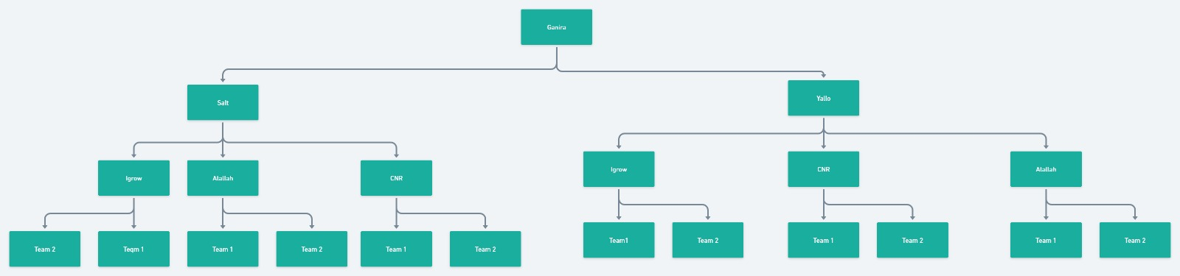

Slide 32
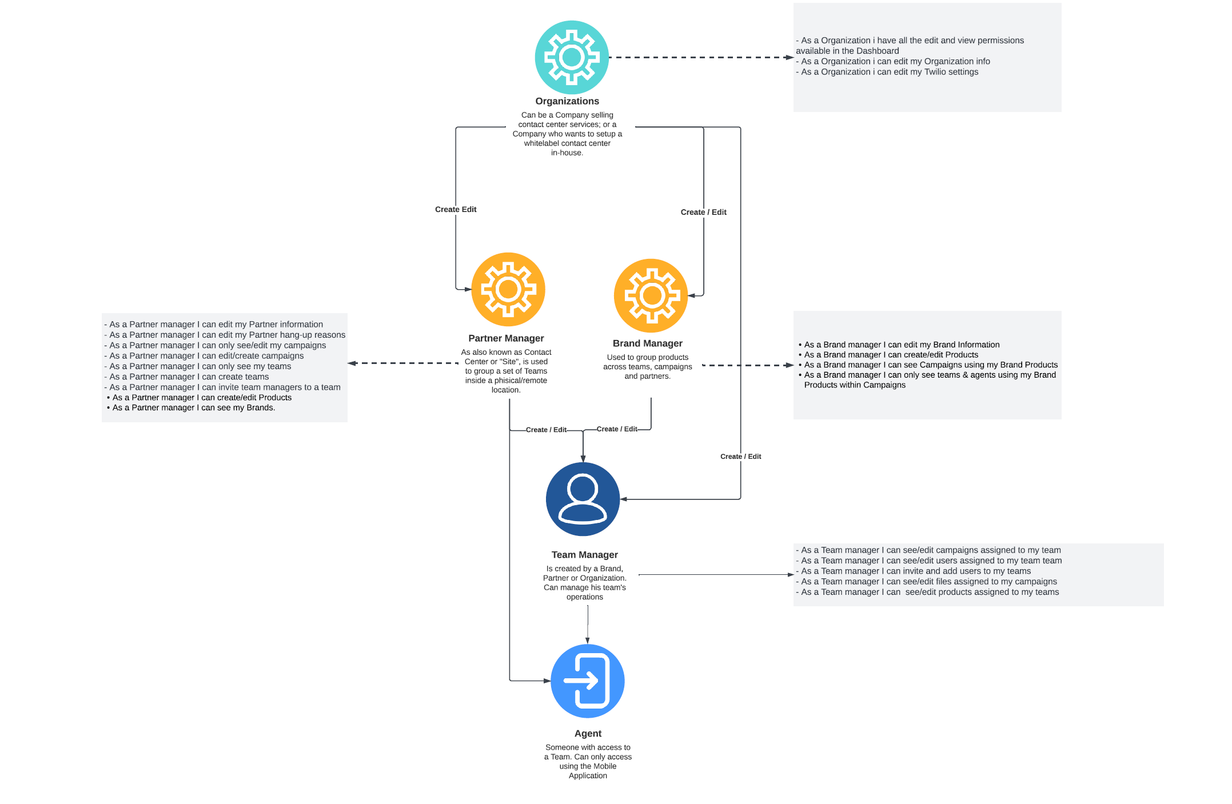

Slide 33
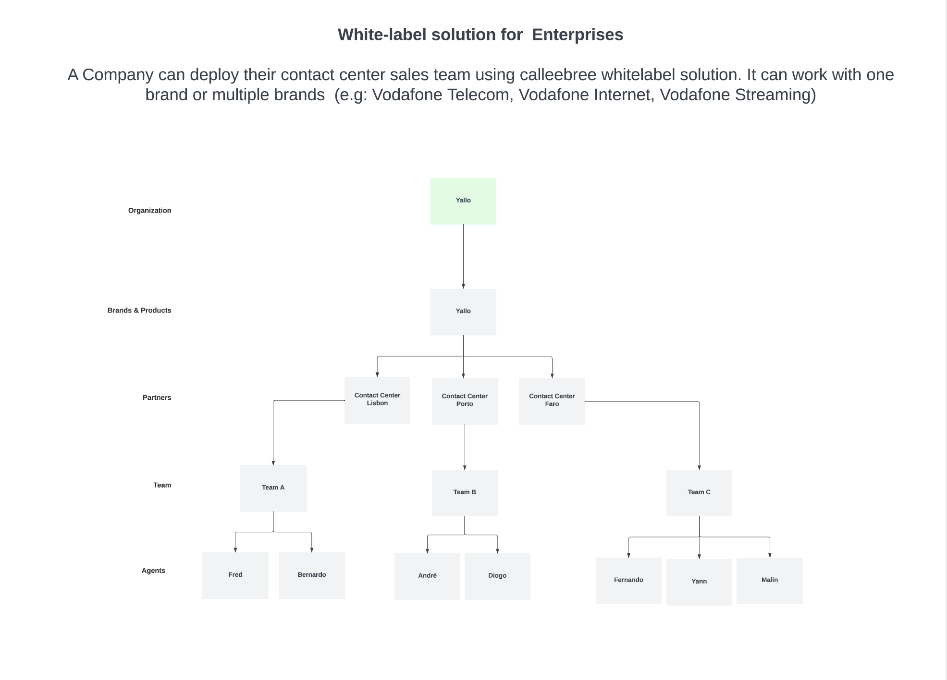

Slide 34
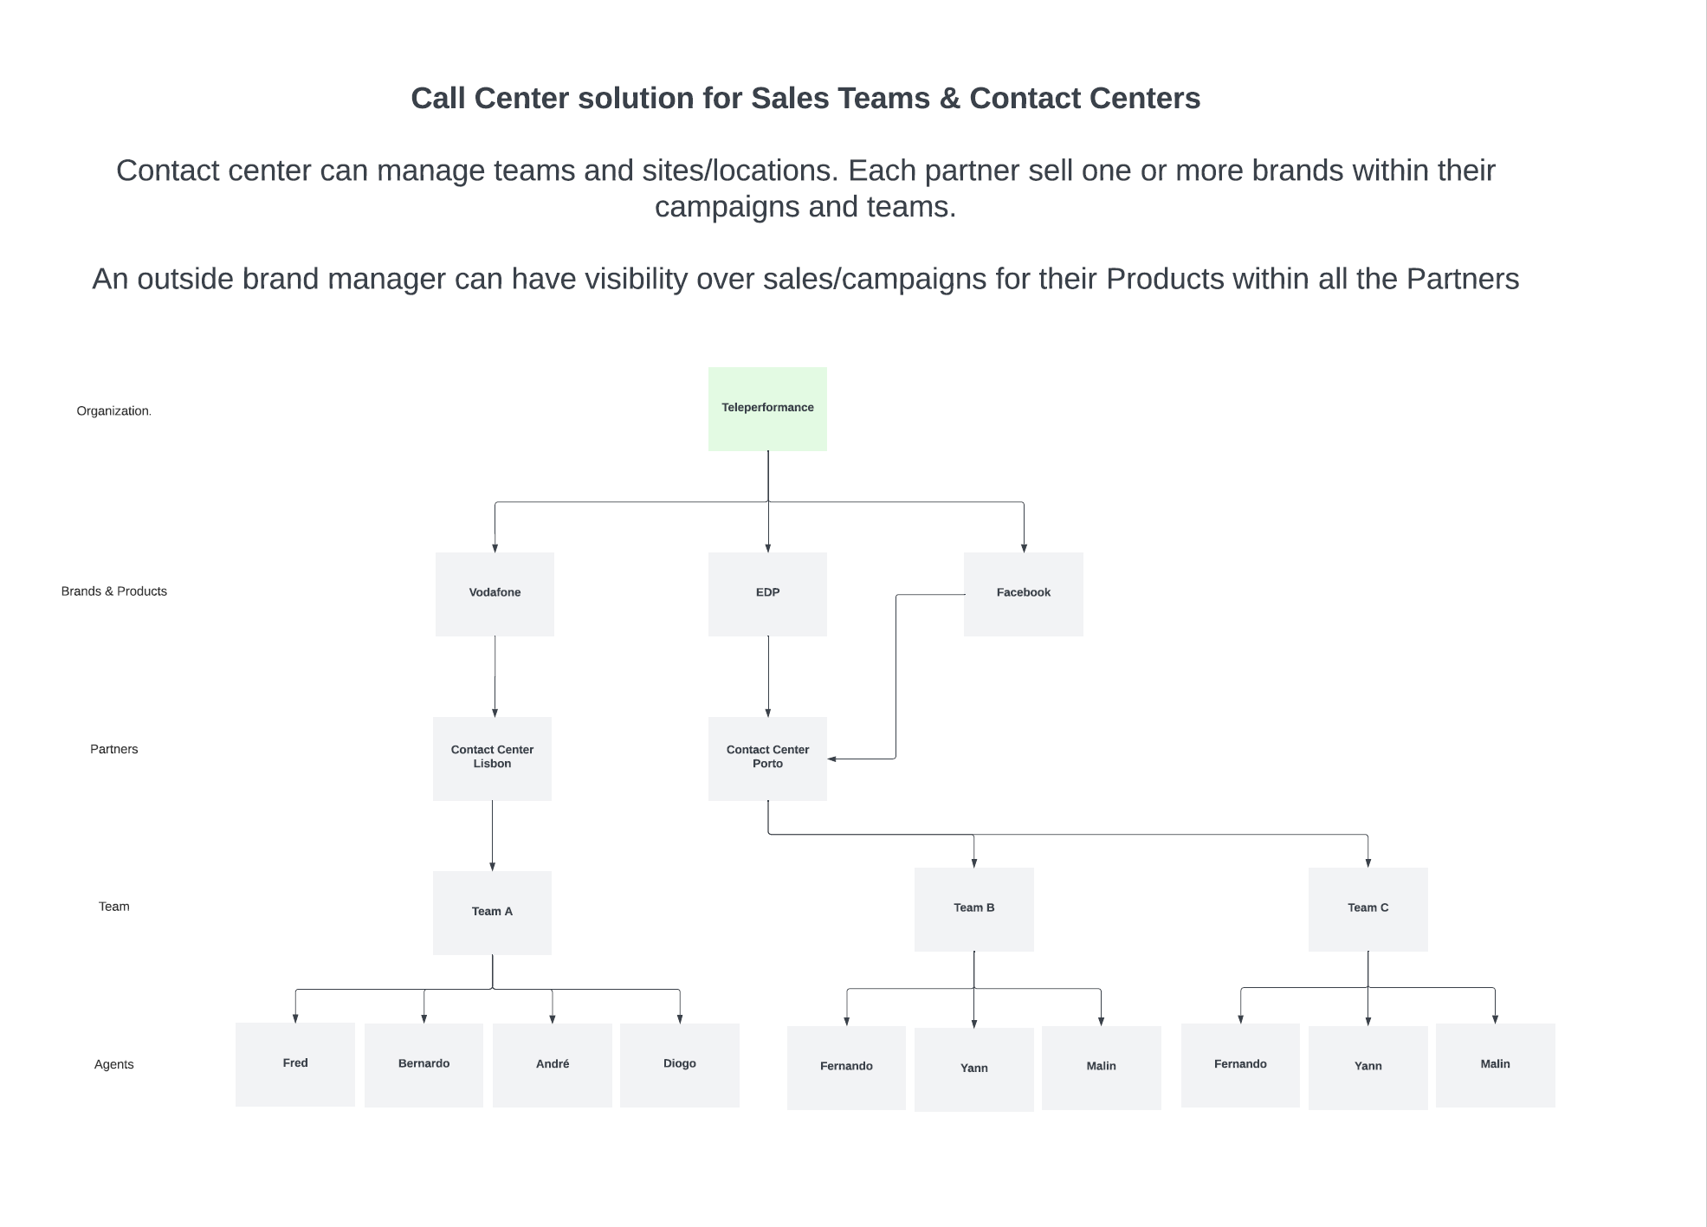

Slide 35
